Slide 1
SEEKING Valuation oN Listed Companies on NYSE, AMEX, NASDAQ
Jeriel Wong
Graduation Project for Data Science Immersive @ General Assembly
Disclaimer: This is educational, there can be losses in investments

Slide 2
If today you would to invest your money in a company, how would you select the company ?
Problem Statement
Technical indicators say it’s going up
‘The company is good ’
Current Ratio
‘I saw on television an analyst recommend this company’
Savvy
Non-Savvy
Gross Margin
Price – to - EPS (P/E)
Price – to - Book (P/B)
‘My friend bought this company stock, and is making money, follow him/her!’
Notes:
You want to do an investment but you don’t know which stock to pick , or actually you do, u believe that this company has an awesome product or an awesome business model

Slide 3
Problem Solution - the financial vitals
A model that predicts the valuation of a company by studying listed companies in the three major exchanges.
With a prediction model, and the current market capitalisation of the company, the differential between predicted and current market capitalisation, will provide investors a list of undervalue/overvalue companies and also a target level to exit the investment.
Through this model development, investors are able to determine which financial indicators tend to have a positive correlation with market capitalisation.

Slide 4
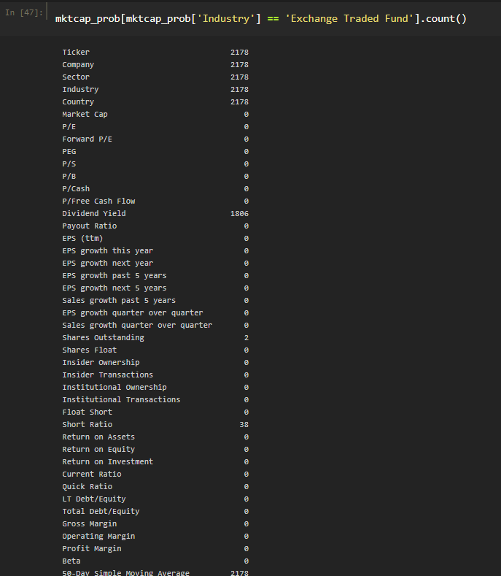
Dataset Insights Exchange Traded Funds
Exchange Traded Funds
Has no Market Cap
Has no Financial data vitals, P/E , Forward P/E, PEG, Sales Growth etc.
Example: SPDR S&P 500 ETF Trust
2178 Exchange Traded Funds that has no market cap

Slide 5
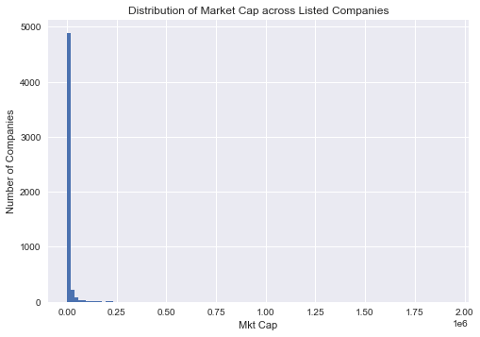
Dataset Insights US $5 Billion TO BE ANALYZED
7565 tradeable tickers
2225 listed tickers no market cap
2178 Exchange Traded Funds
47 Shell Companies & Others
1071 listed companies > US$5 billion valuation, total market cap US$44.9 trillion
4269 listed companies are < US$5 billion valuation, total market cap US$3.8 trillion

Slide 6
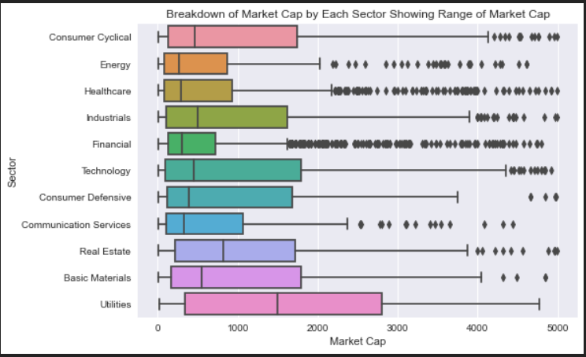
Data Analysis Visualisation - Sector overview – with highest market cap

Slide 7
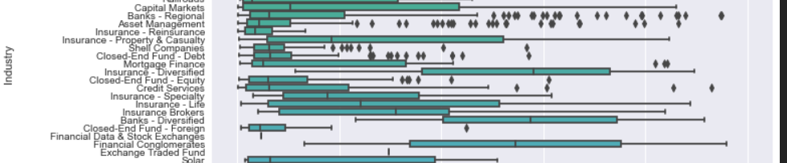
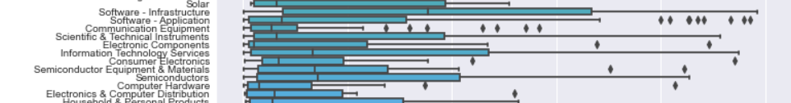
Data Analysis Visualisation - industry overview – with highest market cap
Utilities
Regulated Gas
Financials
Banks Diversified
Technology
Software Infrastructure

Slide 8
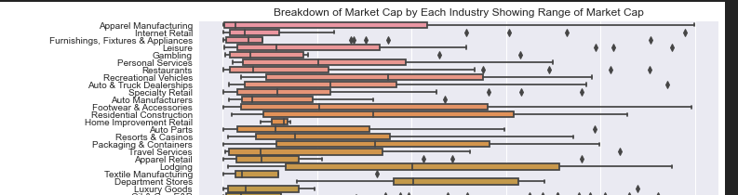
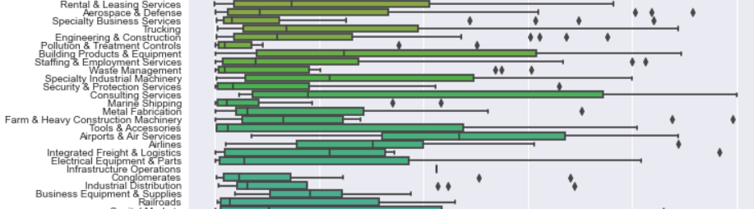
Data Analysis Visualisation - industry overview – with highest market cap
Consumer Cyclical
Department Stores
Industrials
Airports & Air Services

Slide 9
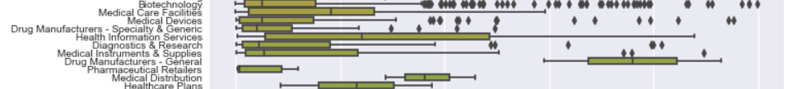
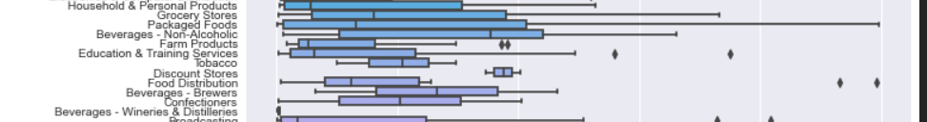
Data Analysis Visualisation - industry overview – with highest market cap
Energy
Oil & Gas Integrated
Data Analysis
via EDA
Healthcare
Drug Manufacturers
Consumer Defensive
Discount Stores

Slide 10
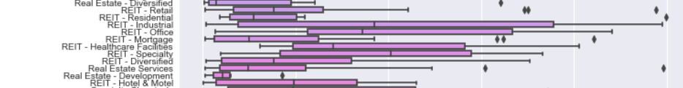
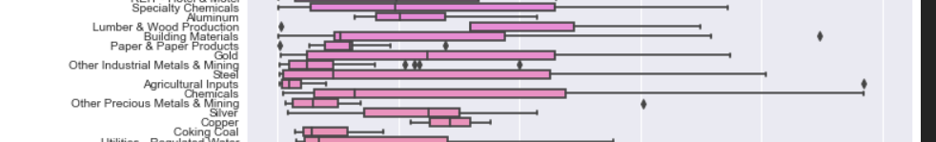
Data Analysis Visualisation - industry overview – with highest market cap
Communication Services
Telecom Services
Real Estate
REIT Speciality
Basic Materials
Lumber & Wood Production

Slide 11
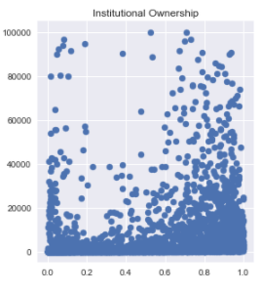
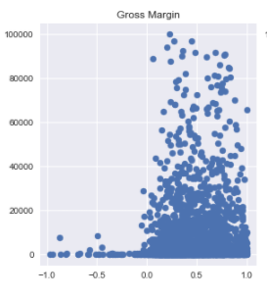
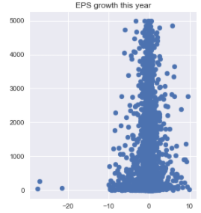
Data Analysis Visualisation – Financial INDICATORS - CORRELATION
Earnings Per Share
Institutional Ownership
Gross Margin
Notes:
EPS = The amount of company’s profit per outstanding share for the company fiscal year
Instituational Ownership = how much of a company is owned by instititutions , 1 means 100%
Institutional ownership is the amount of a company’s available stock owned by mutual or pension funds, insurance companies, investment firms, private foundations, endowments or other large entities that manage funds on behalf of others.
Gross margin : (sell price – cost) / Cost

Slide 12
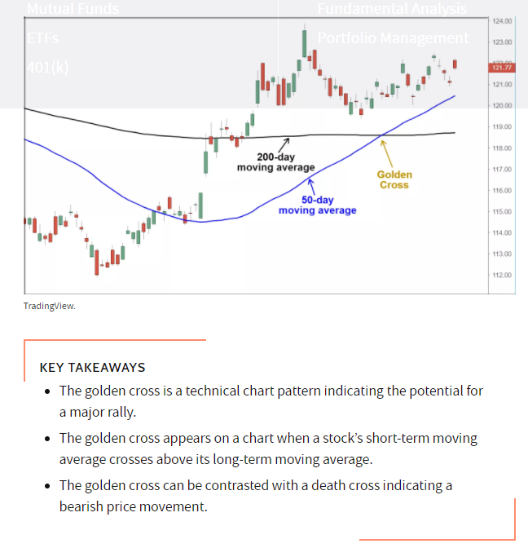
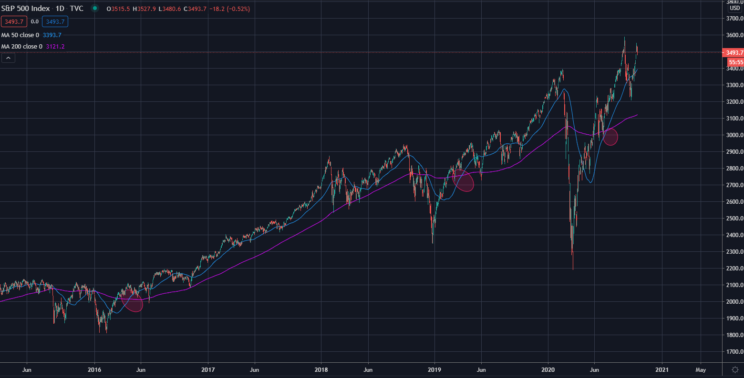
Feature engineering – golden cross strategy

Slide 13
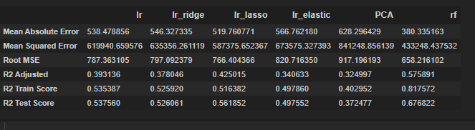
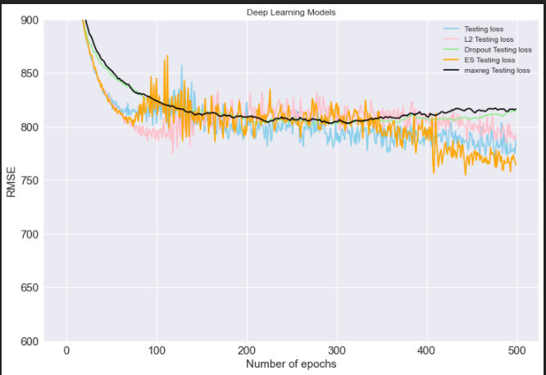
Model evaluation and metrics
Random Forest
RMSE : 658
Highest R2 Adjusted
Train and test score
Notes:
Adjusted R Squared refers to the statistical tool which helps the investors in measuring the extent of the variance of the variable which is dependent that can be explained with the independent variable and it considers the impact of only those independent variables which have an impact on the variation of the dependent variable.
The higher the R2 Adjusted it means the predictors have higher explanatory power for the predicted value

Slide 14
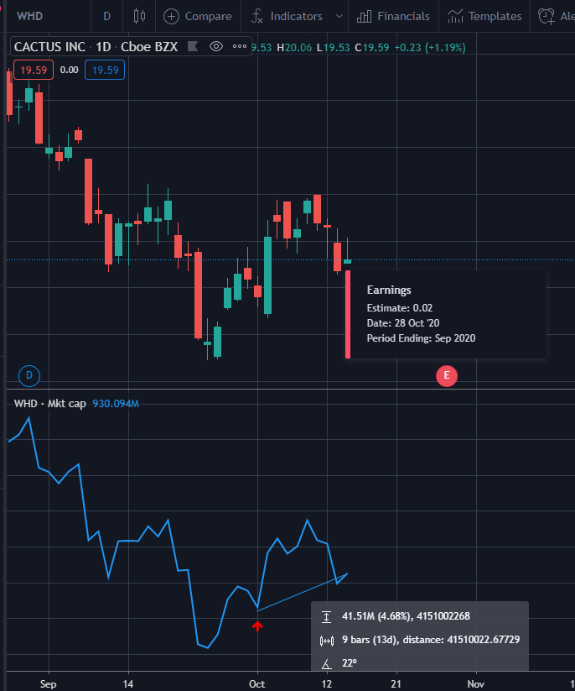
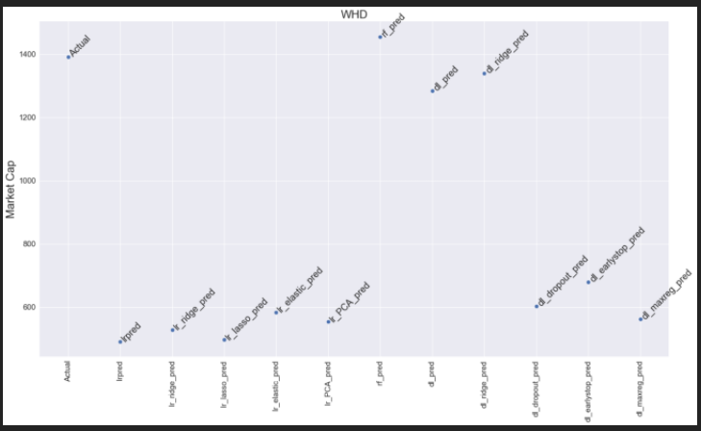
Whd - Cactus, Inc. * Earnings date 28 oct 2020
- Next Earnings Date : 28 Oct 2020
- 01 Oct 2020 Market Cap = US\$1.39 Billion
- 14 Oct 2020 Market Cap = US\$1.51 Billion
- Predicted Value = US\$1.46 Billion
- Sector: Energy , Industry : Oil and Gas Equipment Services
- Insti ownership : 50.7%
- EPS: 1.29
- Gross Margin : 34.9%
- Random Forest Predicts that WHD should increase valuation to $1.46 Billion
- Status: Random Forest prediction on track, super exceed

Slide 15
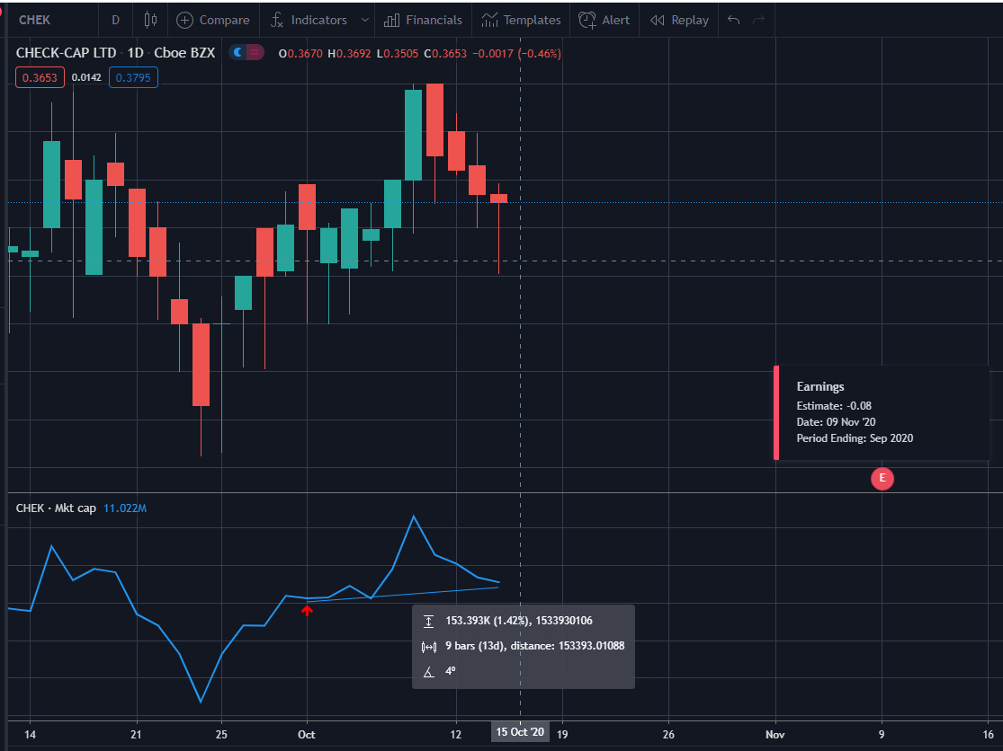
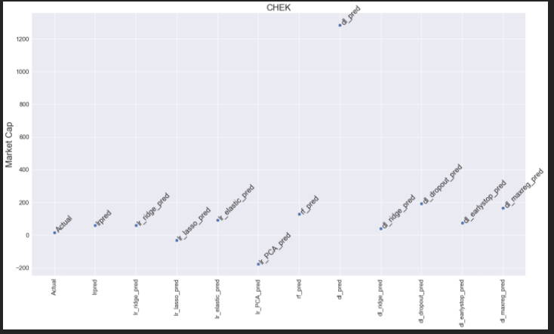
CHEK - Check-Cap Ltd. Earnings date 09 nov 2020
- Next Earnings Date : 09 Nov 2020
- 01 Oct 2020 Market Cap = US\$15.76 Billion
- 14 Oct 2020 Market Cap = US\$17.53 Billion
- Predicted Value = US\$129.45 Billion
- Sector: Healthcare , Industry : Diagnostics & Research
- Insti ownership : 5.9%
- EPS: 0.11
- Gross Margin : 53%
- Random Forest Predicts that CHEK should increase valuation to $129.45 Billion
- Status: Random Forest prediction on track

Slide 16
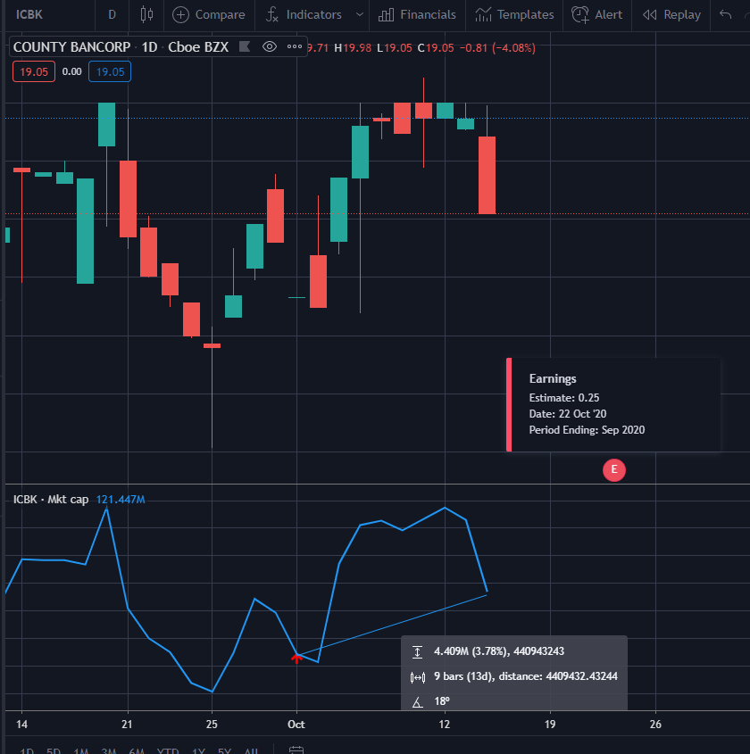
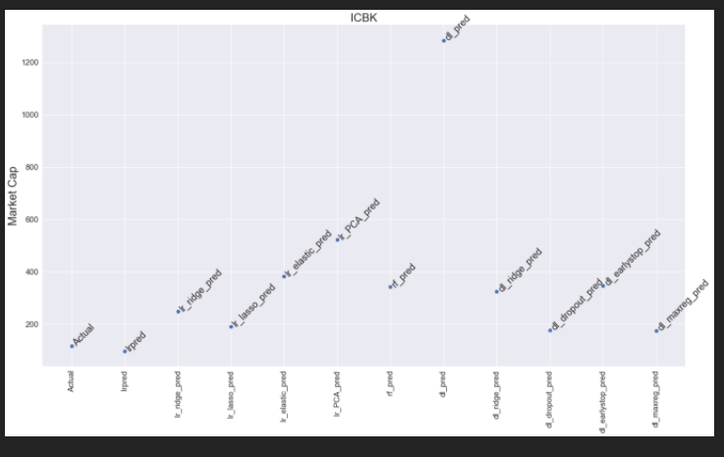
Icbk - County Bancorp, Inc. earnings date 22 oct 2020
- Next Earnings Date : 22 Oct 2020
- 01 Oct 2020 Market Cap = US\$116.4 Billion
- 14 Oct 2020 Market Cap = US\$119.63 Billion
- Predicted Value = US\$314.47 Billion
- Sector: Financial , Industry : Banks - Regional
- Insti ownership : 27.4%
- EPS: 0.90
- Gross Margin : 64%
- Random Forest Predicts that ICBK should increase valuation to US\$314.47 Billion
- Status: Random Forest prediction on track

Slide 17
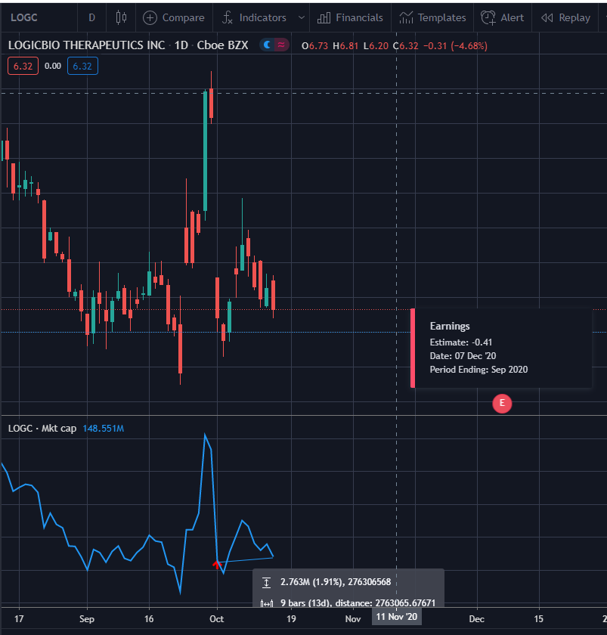
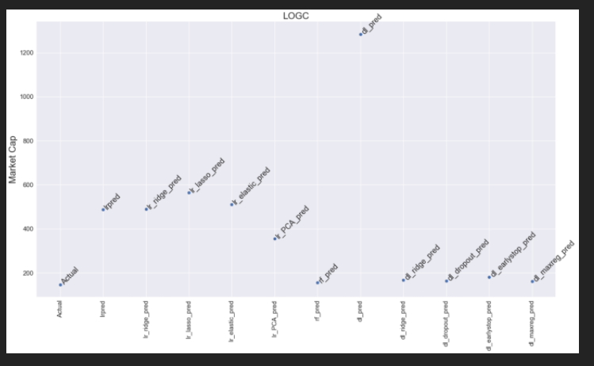
Logc – logicbio therapeutics earnings date 07 dec 2020
- Next Earnings Date : 07 Dec 2020
- 01 Oct 2020 Market Cap = US\$146.57 million
- 14 Oct 2020 Market Cap = US\$213.81 million
- Predicted Value = US\$155.23 Billion
- Sector: Healthcare , Industry : Biotechnology
- Insti ownership : 64%
- EPS: 1.89
- Gross Margin : 53%
- Random Forest Predicts that LOGC should increase valuation to US\$155.23 million
- Status: Random Forest prediction on track, super-exceeded

Slide 18
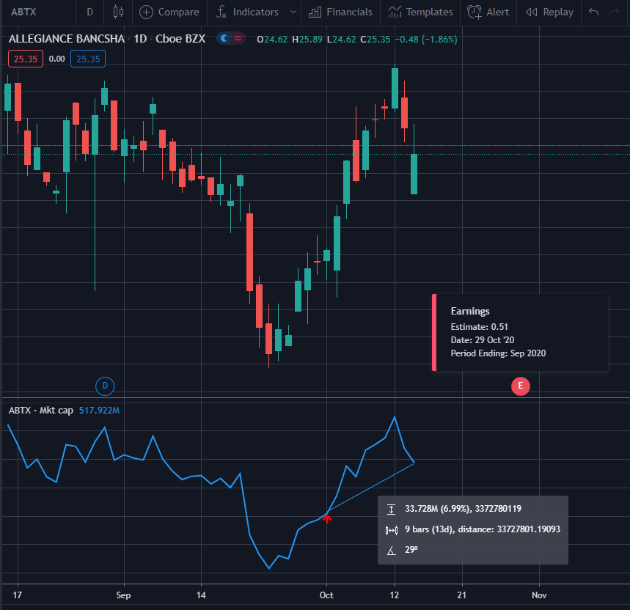
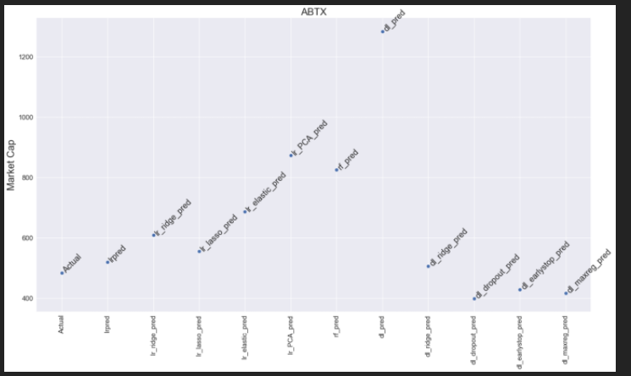
AbTx – allegiance Bancshares earnings date 29 oct 2020
- Next Earnings Date : 29 Oct 2020
- 01 Oct 2020 Market Cap = US\$484.54 Million
- 14 Oct 2020 Market Cap = US\$513.59 Million
- Predicted Value = US\$826.02 Million
- Sector: Financial , Industry : Banks Regional
- Insti ownership : 46.90%
- EPS: 1.88
- Gross Margin : 64%
- Random Forest Predicts that LOGC should increase valuation to US\$826.02 Million
- Status: Random Forest prediction on track

Slide 19
CONCLUSION
Overview
- Random forest,
- Identifying the top determinants of Market Capitalisation
- Predicted Market Cap allows:
- Going long on under-valued companies
- Target level for exit on investment
- Going short on over-valued companies
Notes:
5

Slide 20
Conclusion
Limitations
Under US$5 billion market capilisation analysis:
Companies studied were under US$5 billion, as the number of companies that are <US$5 billion leads to a right-skewed tail distribution.
Time Expiration
Financial data changes every quarterly for companies, hence the predicted market capitalisation will hold till the next financial quarter
Notes:
5 random stocks, turned out to be a double edge sword, it managed to choose all the 5 random forrest that are doing well

